Slide 1
Into the Tidyverse Session 2a
Course written by Tim Hardgreeves

Slide 2
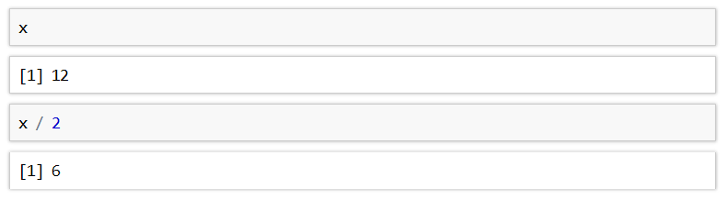
Objects
R is capable of storing any value in an object (also called variables)
Objects are simply a way of labelling a piece of data for later use
In R, objects are assigned using the <- operator
Once an object has been assigned a value, it can be referenced by using its name

Slide 3
Objects
All R statements where you create objects have the form
An object will retain its value until one of the following occur:
You close RStudio
You delete the object manually
You overwrite its value with another
You can see a list of all objects in the 'Environment' pane in RStudio
If you are getting tired of tying <- you can use the keyboard shortcut alt-minus in RStudio to insert

Slide 4
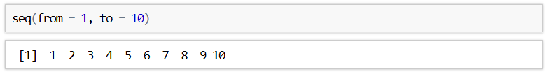
Functions
R has a large collection of built-in functions that are called like this:
An example of such a function is seq() which makes a regular sequence of numbers

Slide 5
Exercises to try
Object_name <- function(arguments)
Create an object called integers and assign a sequence to it using the seq()function. Your sequence should start at 0 and end at 100.
Type into your console : integers ^ 2
How do you think this operator will work on a list of numbers ?
Create an object called x containing 1000 numbers spaced uniformly between -6 and 6.
You can do this by adding the length.out parameter :
seq(from=?,to=?,length.out= ?) and setting it to 1000

Slide 6
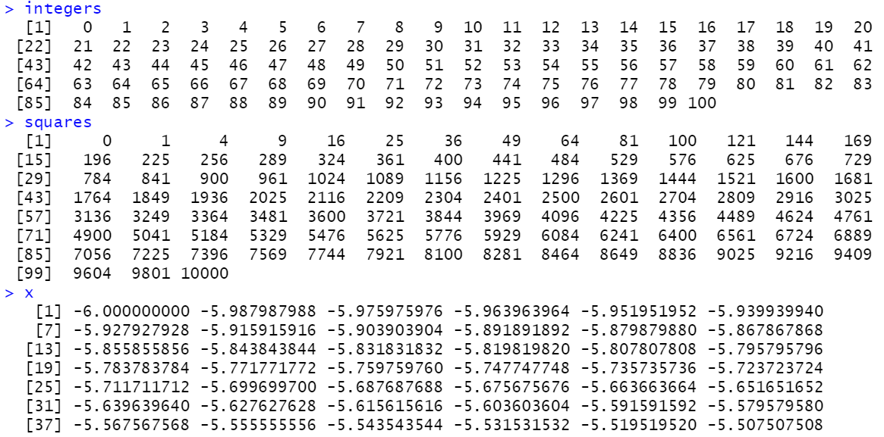
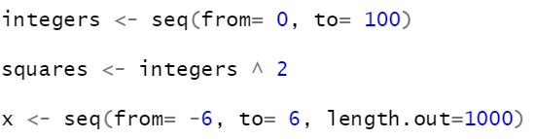
Answers

Slide 7
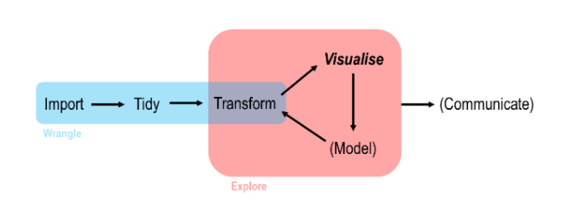
Data Analysis work flow in R

Slide 8
Readr

Slide 9

What is readr
readr is another of the many packages included in the tidyverse
It allows you to import data from a wide variety of storage formats
It is designed to balance import speed, ease-of-use, and consistency

Slide 10
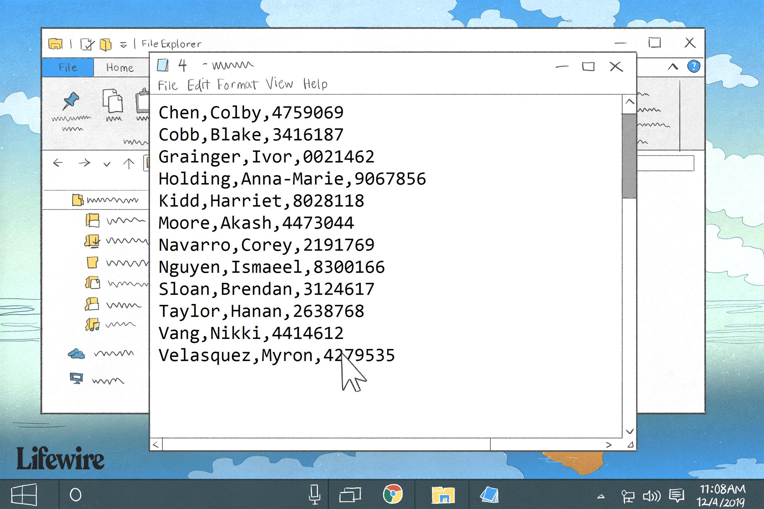
CSV files
Common-separated value (CSV) files are almost certainly the most common storage format for flat data
Each observation occupies its own line and fields are separated by commas (hence the name)
CSVs can contain a header row with column names, although this is not always the case

Slide 11
Paths and Directories

Slide 12
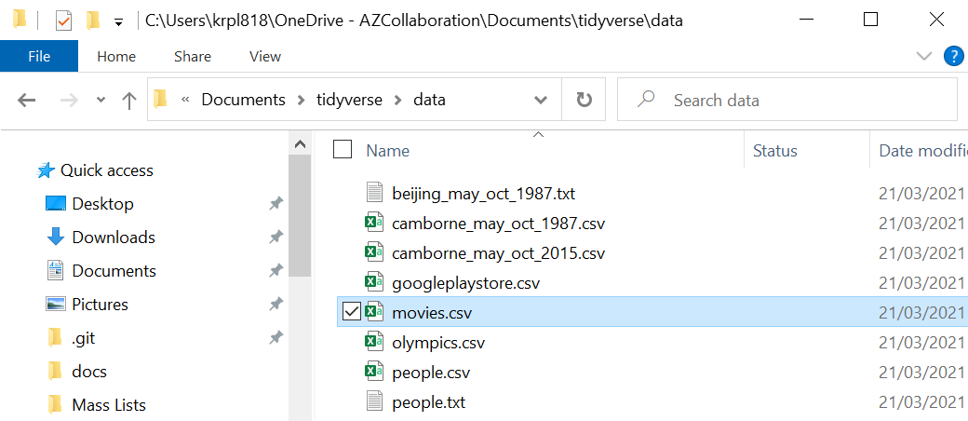
What are paths and directories
Path
Folder /directory
Data files have a name and are located in a folder
A folders is the same a directory
How we get to this folder in our file explorer is our pathway

Slide 13
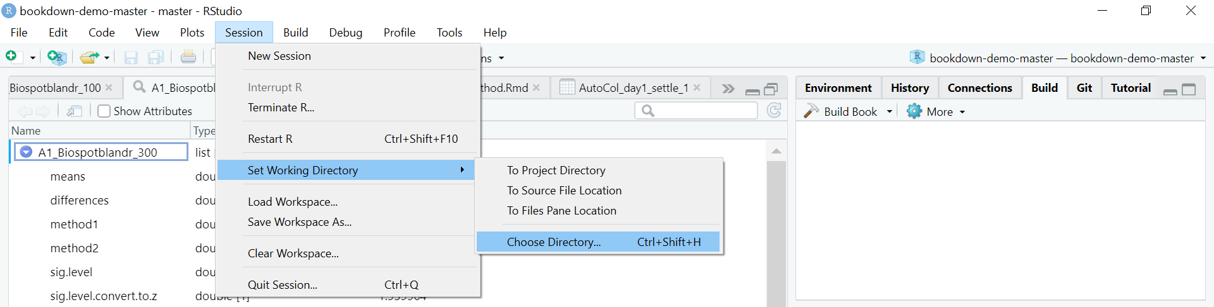
Setting your directory in R
To load datasets into R its always best practice to set our directory to the folder which our datasets are stored in
To do this we can go into session > set working directory > choose Directory > then select the folder with the Tidyverse datasets in

Slide 14
Reading in external data

Slide 15
read_cvs
You can import a CSV file using the read_csv() function
The first argument is the most important it's the path to the file to read or if you’re working directory is set to the folder where the data is stored then just the file name
The path of the file should be relative to your current working directory
This can be changed using Session > Set Working Directory > Choose Directory or by using Ctrl+Shift+H

Slide 16
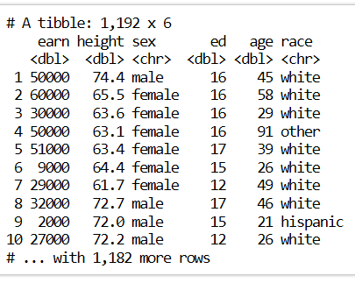
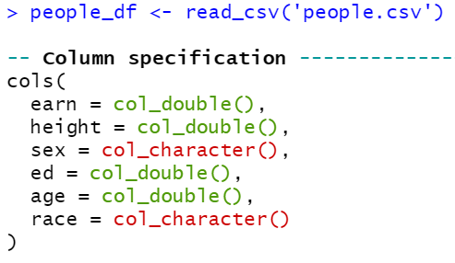
read_cvs
When using the read_csv() function, you are outputted a message containing the column names and types

Slide 17
Exercise to try
Object_name <- read_csv('filename.csv')
Create an object called movies_df and read in the movies.csv file to this object you should now be able to see this dataframe in the environments tab
Select the first 5 rows of this movies_df object
(Make sure to have changed your directory to the folder where the datasets are stored or alternatively write the whole path the the file in the command )

Slide 18
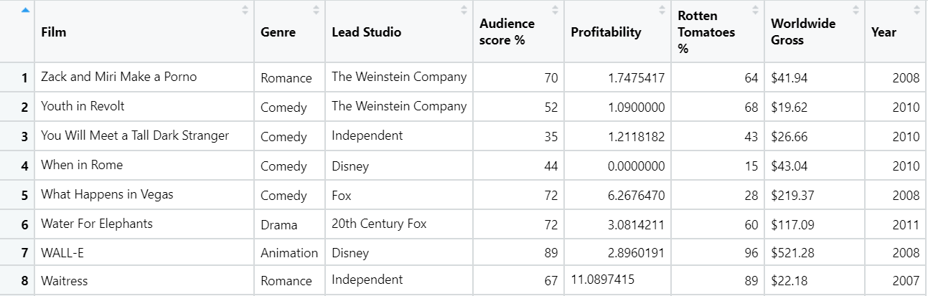
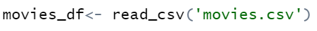
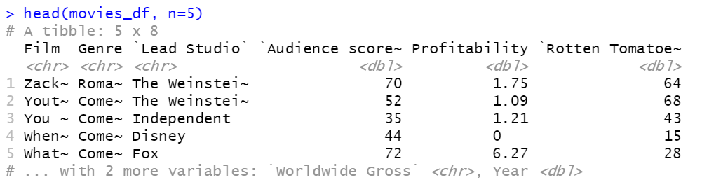
Answer

Slide 19
Tibbles

Slide 20
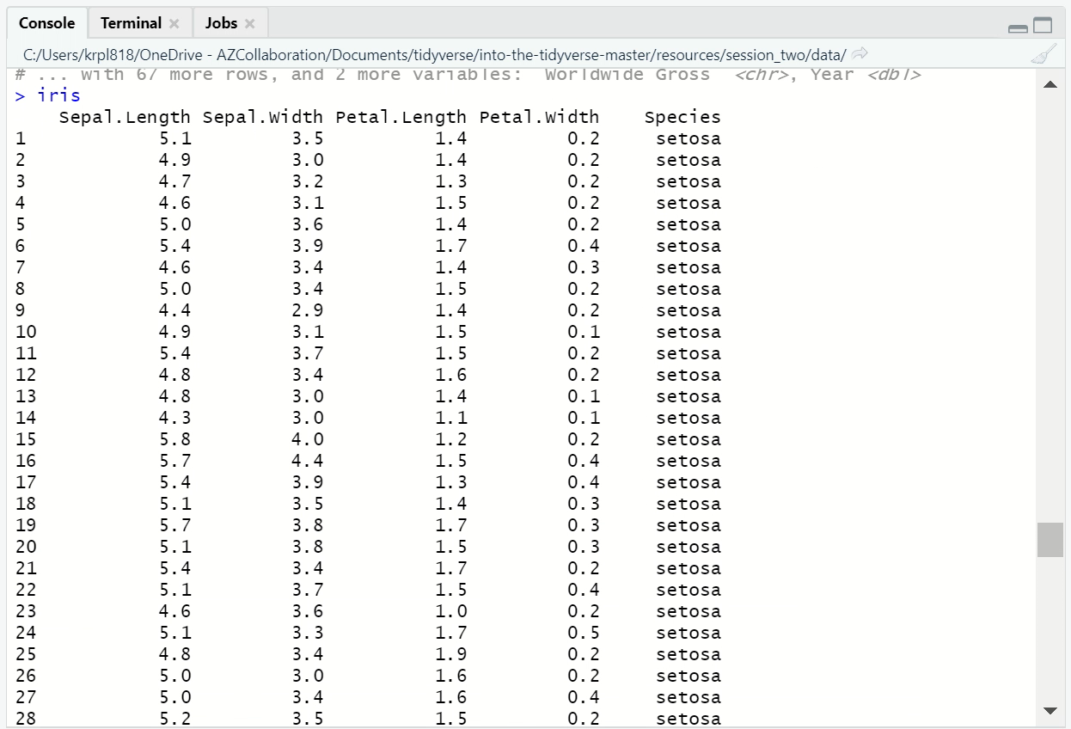
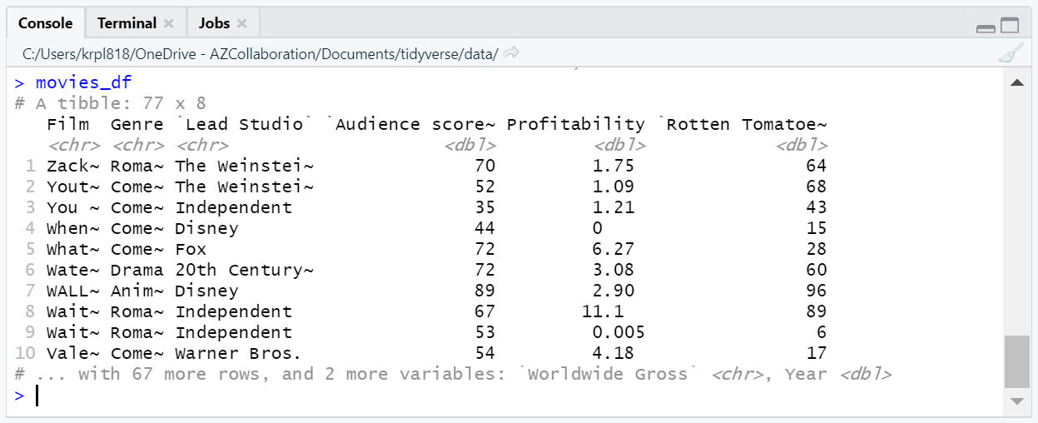
Tibbles

Slide 21
Tibbles
Tibbles are just standard R data frames, but they tweak some old behaviours to make life a little easier
Tibbles limit how many rows and columns to avoid flooding the console
They also give you useful tips such a column types and the dimension of the data frame
A standard R data frame can be converted to a tibble using the as_tibble() function

Slide 22
Data input inside the script

Slide 23
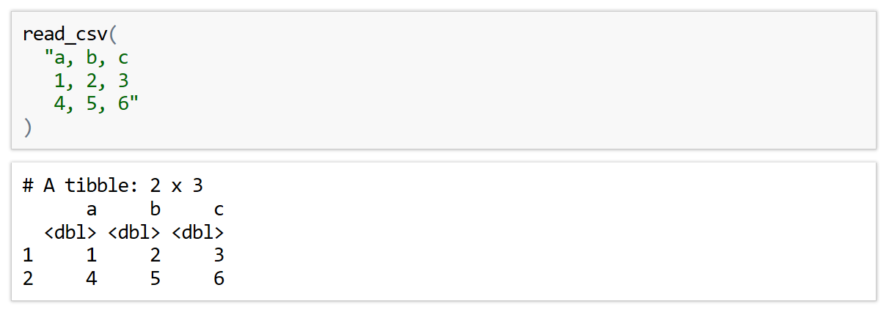
In-line CSV
For the purposes of testing code, the read_csv() function can process an in-line CSV
This is also important for creating reproducible examples

Slide 24
Readr parameters

Slide 25
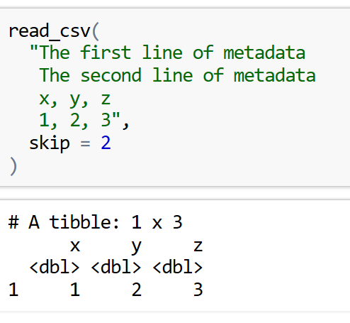
Skip Parameter
Sometimes we have metadata / comments at the top of our files that we don’t want to include
To prevent reading in these lines we can use the skip or comment arguments
The skip argument can be used to skip a specified number of rows in the CSV file before starting to read data
This is useful when your CSV contains metadata at the top of the file

Slide 26
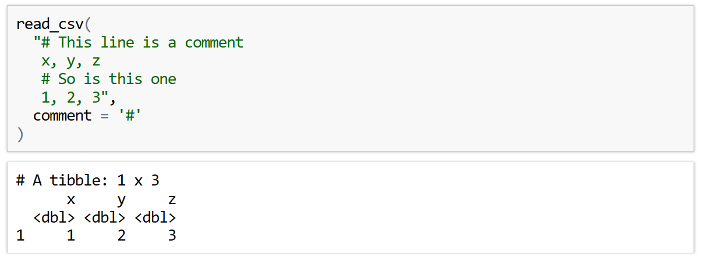
Comment Parameter
The comment parameter can be used to drop all lines starting with a specified character

Slide 27
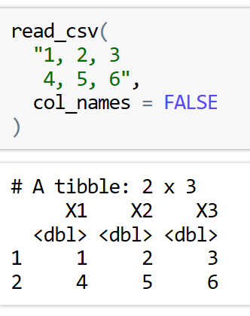
Manual Column names
It may be the case that the CSV file you are importing does not have column names
In this case you can use the col_names parameter to control what to do
Setting col_names = FALSE will tell read_csv() that the first row of the CSV file is data and that the column should be labelled using generic names 'X1', 'X2', etc.

Slide 28
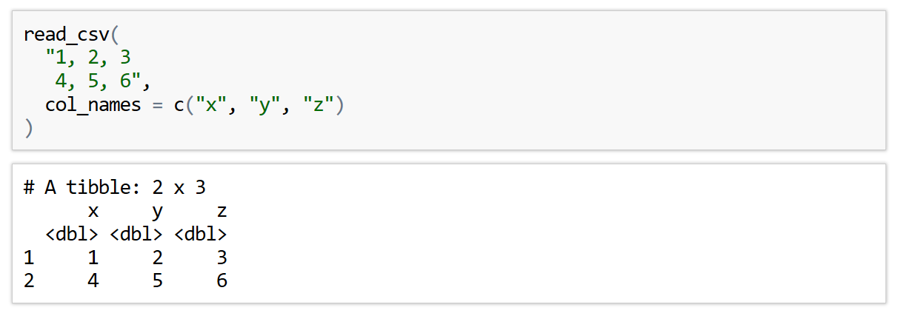
Manual Column names
Alternatively, if you know what the column names should be, you can specify then using a character vector

Slide 29
Exercise to try
Read the following in-line CSV into R. Things to note:
The columns of this dataset are City, Area, Population they’re not already present
Make sure you don’t try to read the comment line
Template:
read_csv(
"data1a , data2a ,data3a
data1b , data2b , data3b",
comment = '?',
col_names=c('name1','name2','name3'))
"Shanghai, 6341, 27058000
Tokyo, 627, 13515271
Seoul, 605, 9806000
>> Mumbai was previously called Bombai
Mumbai, 438, 12442373 "

Slide 30
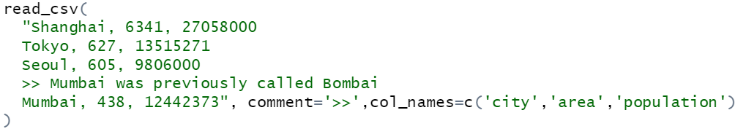
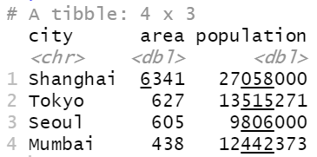
Answer

Slide 31
Calculations

Slide 32
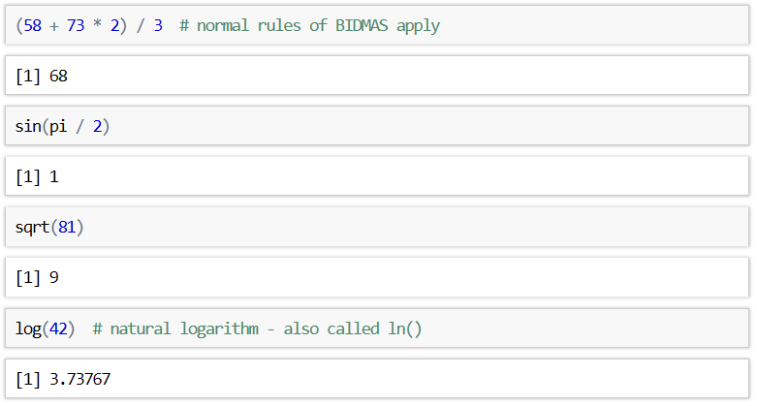
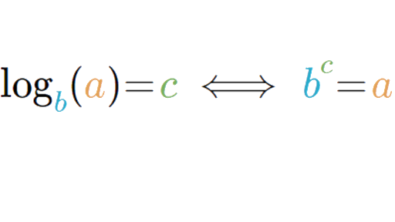
R as a calculator
We can also use things like trigonometry, square roots and logs in r
Normal format
R format
log(a,b)

Slide 33
Bonus Questions

Slide 34
Web Scraping
Web scraping is a technique for converting the data present in unstructured format (HTML tags) over the web to the structured format which can easily be accessed and used
We can use Web browsers to retrieve these datasets
We first need to install rvest and robotstxt :
install.packages('rvest’)
install.packages(‘robotstxt’)

Slide 35
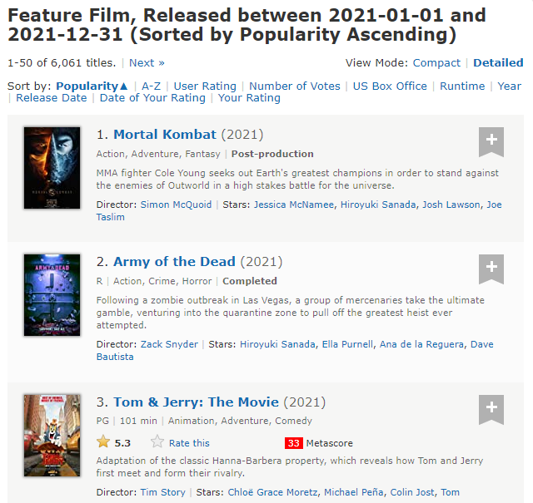












Looking at featured films dataset
We can scrape the following data categories:
Rank
Title
Description
Runtime
Genre
Rating
Director
Actor

Slide 36
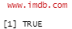
Web Scraping
We’re going to looking at film data from this link:
https://www.imdb.com/search/title/?year=2021&title_type=feature&
Lets check if we can scrape data from It firstly
Opening it in R Studio:

Slide 37
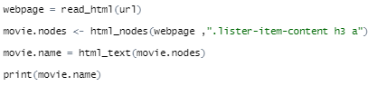
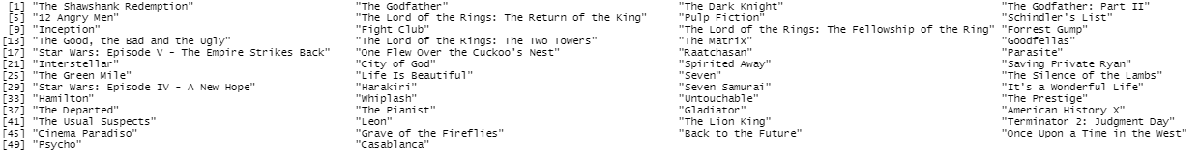
Accessing the categories
We have our variable webpage containing the html dataset but we want to access the data to see it:
Html object
Path to node

Slide 38
Access other variables using these paths
Have a go by copy and pasting these paths to access different categories of data
Year of release – ".lister-item-content h3 .lister-item-year"
Runtime – ".lister-item-content p .runtime"
Genre – ".lister-item-content p .genre"
Certificate – ".lister-item-content p .certificate"
More explanations and documentation can be found here for web scraping :
https://blog.rsquaredacademy.com/web-scraping/
If you want a have a go at creating some plots using this data or creating Dataframes from it have a read of this article:
https://towardsdatascience.com/introduction-to-data-frames-in-r-b9a6302d9a56

Slide 39
Next Time ….
Vectors
Plotting our new datasets
Line graphs
Global aesthetics
See you then !

Slide 40
Into the Tidyverse Session 2b
Course written by Tim Hardgreeves

Slide 41
Vectors

Slide 42
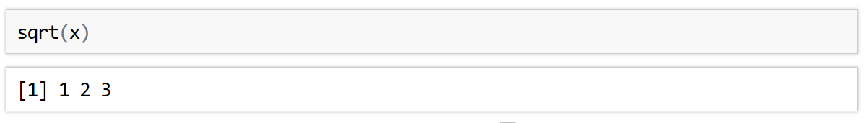
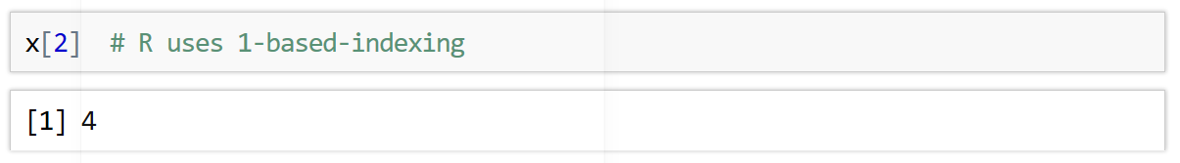
Vectors
In R, a vector is a collection of elements of the same type
There are integer vectors, character vectors, double vectors, and many more
Vectors are created using the c() function. This stands for combine:
Most mathematical functions in R act element-wise on vectors
A particular value of a vector can be accessed using [ ]

Slide 43
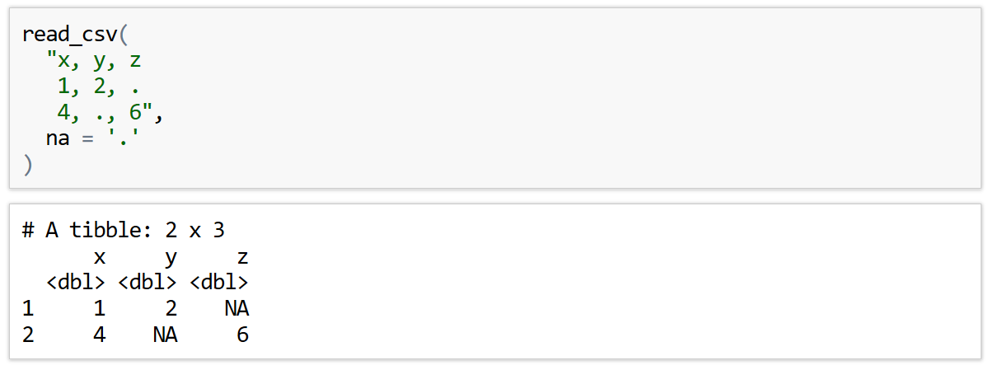
Missing Values
In the real world, it is rare to ever have a complete data set
Missing values can be encoded using a range of symbols - ., ?, N/A, -, etc.
You can tell readr() which symbol is used in a given CSV file using the na parameter

Slide 44
Exercise to try
Read the following in-line CSV into R.
Unknown is used here to represent missing values
There’s a few lines you will want to skip
"
Employee Database Version 3
name, age, job
John, 34, Analyst
Ann, 44, Consultant
Barry, 24, Unknown
Freya, Unknown, Developer"

Slide 45
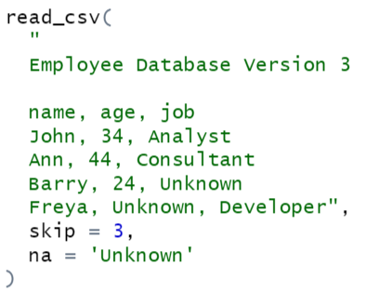
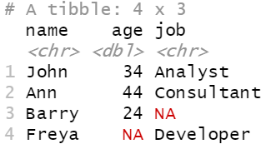
Answer

Slide 46
More file types

Slide 47
Other file types
More Delimited Files
read_csv2() - semicolon-separated files
read_tsv() - read tab-separated files
read_delim() - reads files with any delimiter
read_delim('path/to/file.txt', '|’)
These all accept the same additional arguments as read_csv()

Slide 48
Exercises to try
Facet the above plot by sex, colouring the points too. Make sure you hide the legend with show.legend = FALSE
Remember to set your working directory first with Session > Set Working Directory...
Read the people.csv file from this session’s data folder. Make sure you specify that sex and race are factors (categorical variables) and that earn and age are integers.
How does level of education affect salary? Make a scatter plot to find out. You should set position = 'jitter' in the geom_point() function to avoid over-plotting and perhaps also set transparency to 0.5.
Facet the above plot by sex, colouring the points too. Make sure you hide the legend with show.legend = FALSE

Slide 49
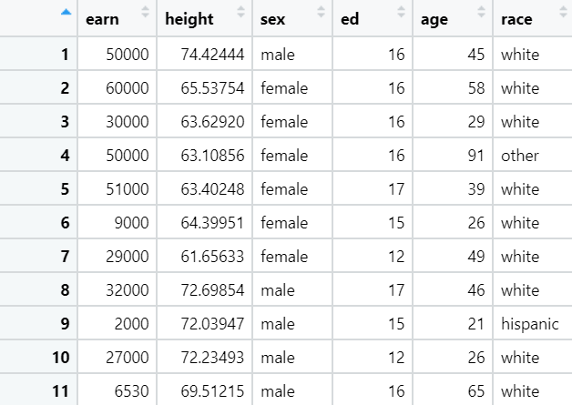
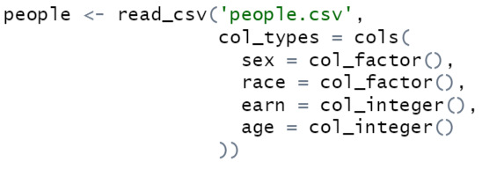
Answers 1)

Slide 50
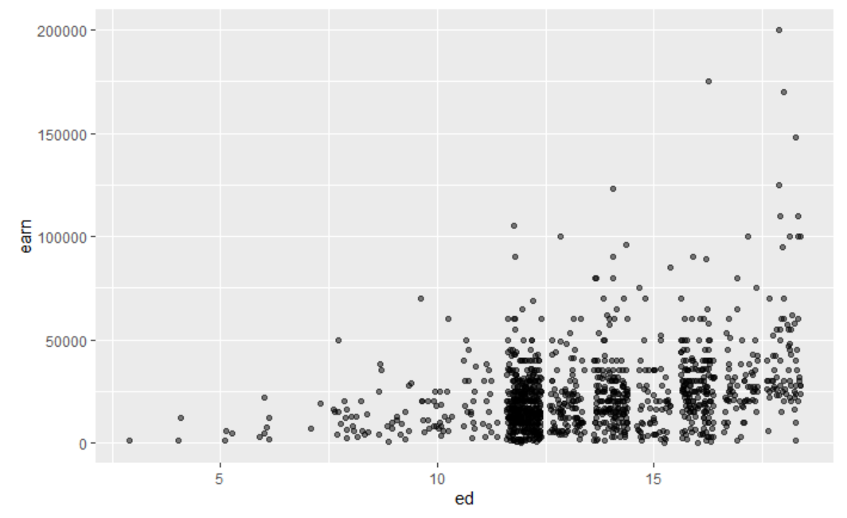
Answers 2)

Slide 51
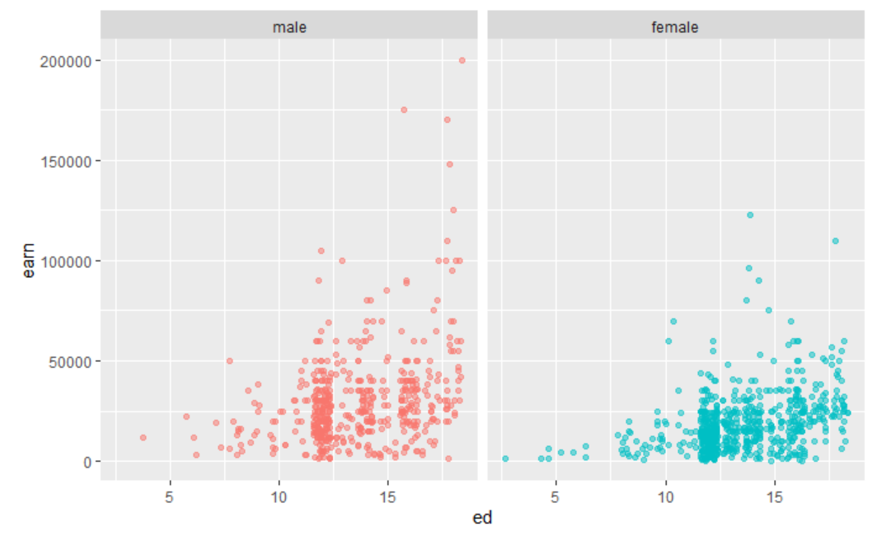
Answers 3)

Slide 52
More Data Visualisations

Slide 53
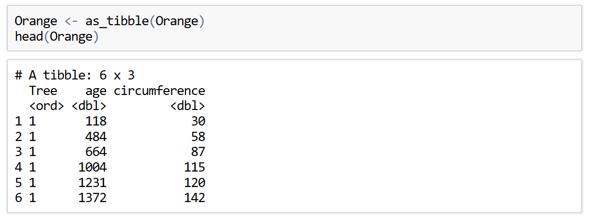
Line Plot
So far, we have only produced scatter plots and that's a bit boring
By changing which geometry we use, we generate a line plot
A dataset suited to this type of graph is the oranges dataset

Slide 54
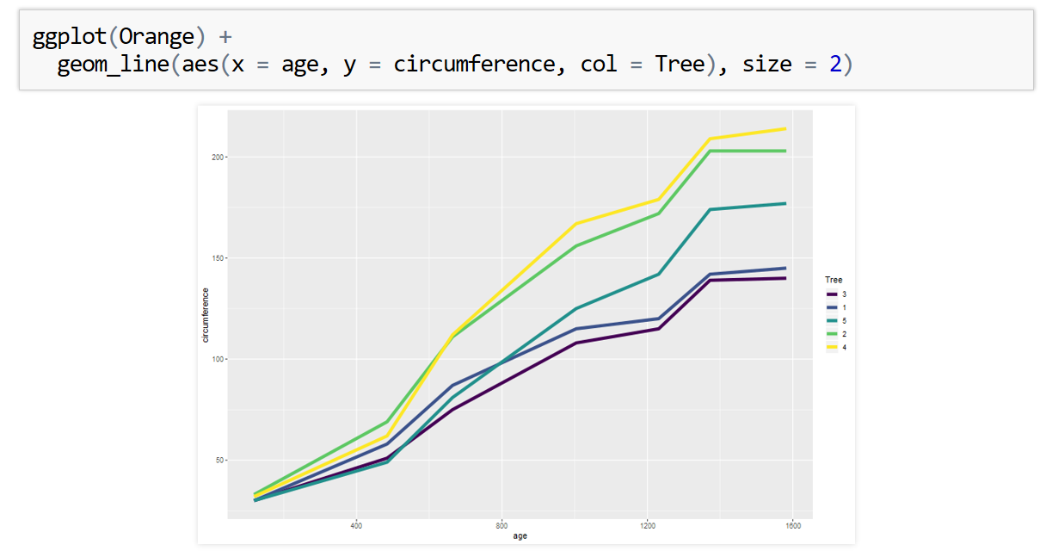
Line Plot
A line plot is produced by using the geom_line() geometry

Slide 55
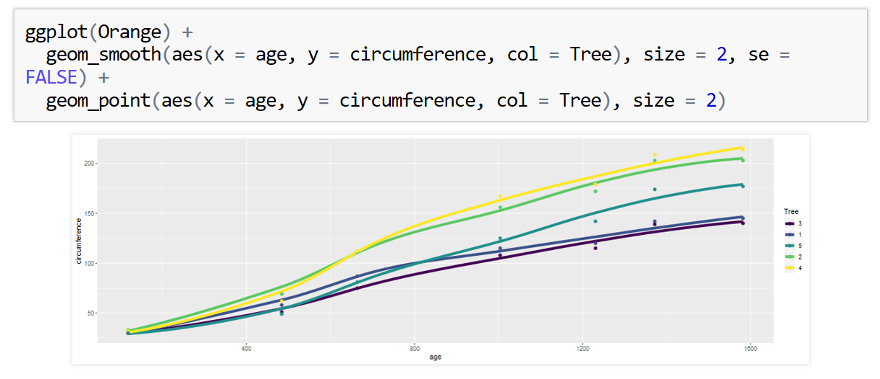
Smooth Line Plot
A similar geometry is geom_smooth(). This adds a smooth fitted line to a plot
This can be combined with geom_point() to create the following graph
Use can use the se parameter to control whether confidence intervals are shown. These are best turned off for now

Slide 56
Exercises to try
Using the built in dataset ChickWeight make a line plot of the chicken weight against time. Group by chick and colour by diet by adding group = chick inside the aes() function
Instead of using geom_line, use geom_smooth with the colour aesthetic set to Diet. Hide the error regions with se=FALSE
There is no need to specify the group in this case - why?
3) Add labels to the plot

Slide 57
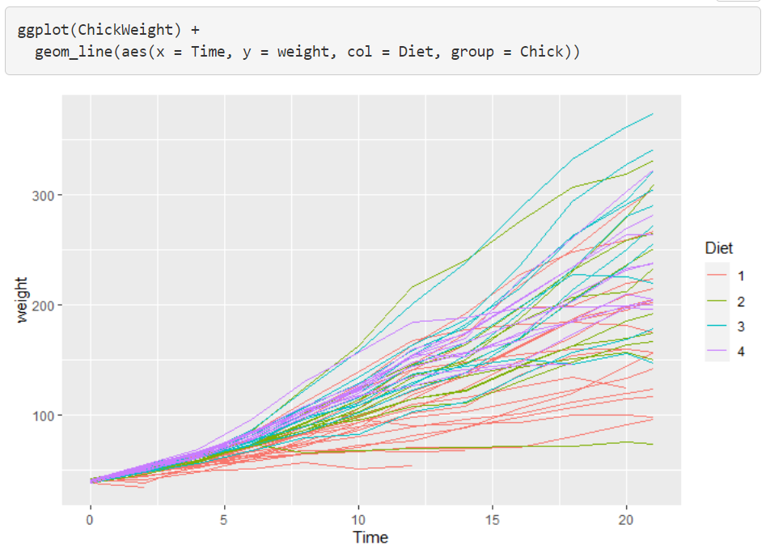
Answers 1)

Slide 58
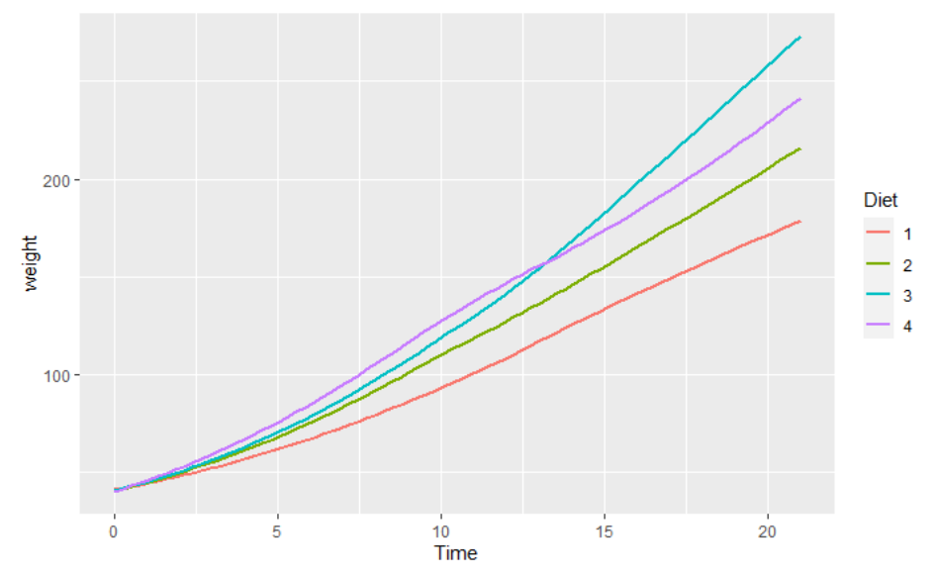
Answers 2)

Slide 59
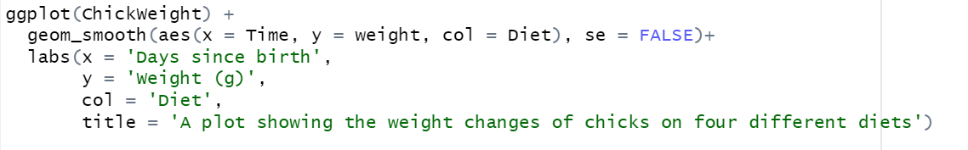
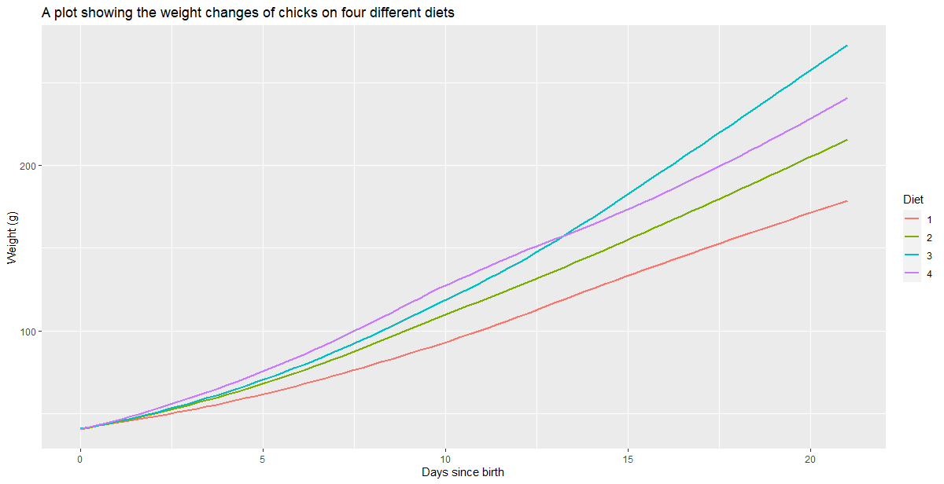
Answers 3)

Slide 60
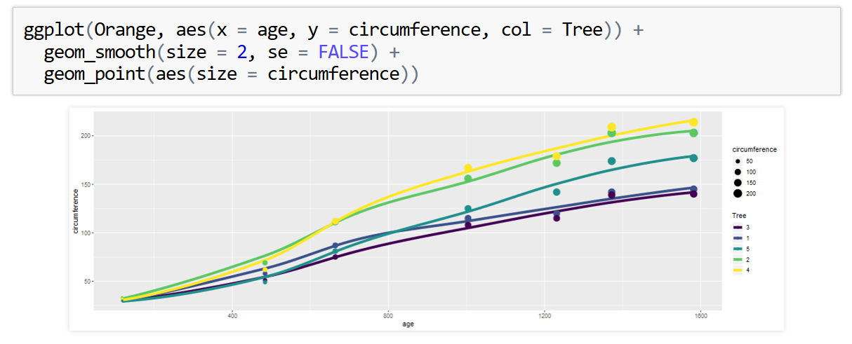
Global Aesthetics
The previous code is repetitive as we specify the mapping for aesthetics x, y, and col twice
We can instead specify these as the second argument of ggplot() in aes()
These will be treated as global variables mappings
You can still specify local mappings in either of the geometry functions

Slide 61
More Line Aesthetics
Both line graph geometries both come with a linetype aesthetic to control what type of line is used
This should have a categorical variable mapped to it or manually set to a positive integer value/name of a line type
Both aesthetics also has a group() aesthetic which allows you to separate the full data set before generating the lines (see exercises for examples of this)
This can be set to -1 to use no grouping

Slide 62
Bonus Questions

Slide 63
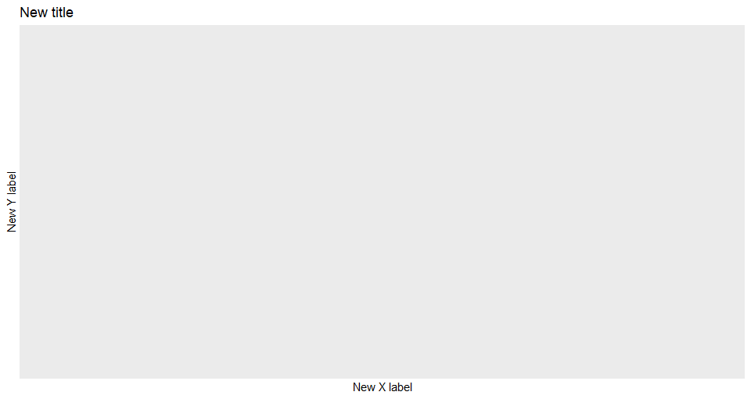
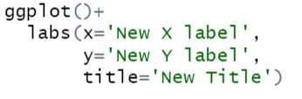
Labelling
We can change our x and y axis names in ggplot and add a title to our graph using a new layer labs()
It’s a simple case of adding more layers to our code as shown bellow:

Slide 64
Exercises to try
Add a new title and x and y axis names to the following plot from before
ggplot(ChickWeight) +
geom_smooth(aes(x=Time, y=weight, col=Diet), se=FALSE)

Slide 65
Answers 1)

Slide 66
Next Time ….
Basic statistical functions
Using comparisons to filter data
Using Boolean operators
See you then !

